Slide 1
Simple Snake
CECS 361 Fall 2021
Pi Oliver Justin Salazar Mariam Bekhit

Slide 2
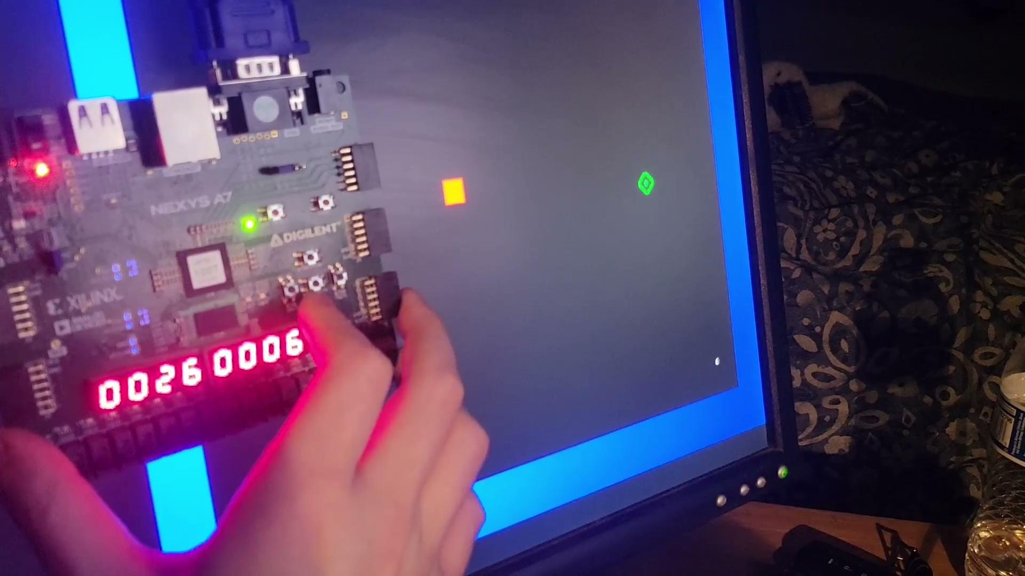
RUNTIME
Game Runtime
Controlled via onboard pushbuttons (Left, Right, Up, Down).
Score increments upon snake colliding with apple.
Time increments every second.
Apple randomizes location after being eaten.
Reset stats and snake position upon colliding with boundary.

Slide 3
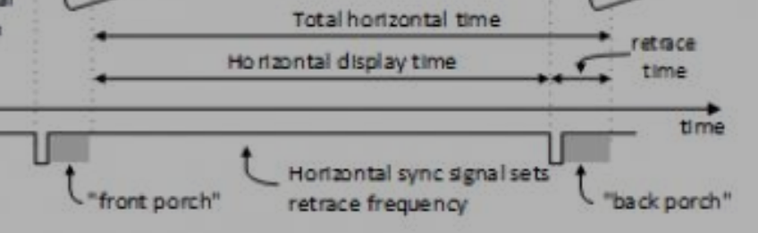
VGA
VGA timing standard for 640 x 480 resolution @ 60 Hz with a 25 MHz pixel clk
12-Bit RGB output, 4-bits per color.
25 MHz Pixel clock
Parameter | Time (Vsync) | Lines (Vsync) | Time (Hsync) | Clks (Hsync)
Sync Pulse | 16.7ms | 521 | 32us | 800
Display Time | 15.36ms | 480 | 25.6us | 640
Pulse Width | 64us | 2 | 3.84us | 96
Front Porch | 320us | 10 | 640ns | 16
Back Porch | 928us | 29 | 1.92us | 48
*From board reference manual

Slide 4

SEVEN SEGMENT
8 x 7-Segment Display
8 Anodes, 8 Cathodes, shared between digits.
Display multiplexing is used to display game time (left) and score (right) with limited connections.
Switching between digits occurs so quickly, human eye perceives image at static.
An example of the display multiplexing slowed down to 4Hz

Slide 5
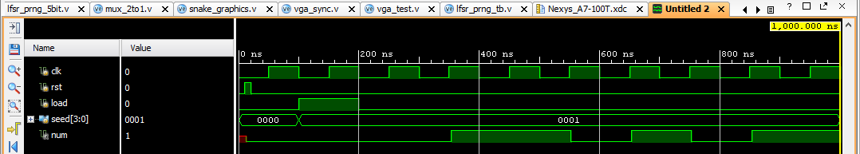
LINEAR FEEDBACK SHIFT REGISTER
We implemented a Linear Feedback Shift Register to generate a Pseudo-Random sequence that outputs 5-bit number per generator. Our pseudo-random sequence has a period of 15 clk cycles before it overflows and repeats from the first value.

Slide 6
REFERENCES
Krishnajith S S Follow Student at National Institute of Technology. “Snake Game on FPGA in Verilog.” SlideShare, https://www.slideshare.net/sskrishnajith/snake-game-on-fpga-in-verilog.
Pong Game, https://www.fpga4fun.com/PongGame.html.
user3100088user3100088 30533 gold badges88 silver badges1919 bronze badges, et al. “Snake Game Using FPGA (Altera).” Stack Overflow, 1 Mar. 1962, https://stackoverflow.com/questions/20839209/snake-game-using-fpga-altera.
P. P. Chu, “VGA Controller I: Graphic” in FPGA Prototyping by Verilog Examples Xilinx Spartan-3 Version. Hoboken, NJ: Wiley, 2008, ch. 13, pp. 309-340. P. P. Chu, “VGA Controller I: Graphic” in FPGA Prototyping by Verilog Examples Xilinx Spartan-3 Version. Hoboken, NJ: Wiley, 2008, ch. 13, pp. 309-340.
N. V. Satanarayana Murthy, “Video Graphics Array interfacing through Artix-7”, International Research Journal of Engineering and Technology (IRJET), vol. 3, issue 3, pp. 1688-1695 Available: https://www.irjet.net/archives/V3/i3/IRJET-V3I3353.pdf
Digilent, Nexys A7 Reference Manual, Digilent [Online]. Available: https://digilent.com/reference/programmable-logic/nexys-a7/reference-manual
Video Electronic Standards Association (VESA), VESA and Industry Standards and Guidelines for Computer Display Monitor Timing (DMT), VESA [Online]. Available: https://glenwing.github.io/docs/VESA-DMT-1.13.pdf
Dell, Dell™ ST2010-BLK Flat Panel Monitor User's Guide, Dell [Online]. Available: https://downloads.dell.com/manuals/all-products/esuprt_electronics/esuprt_display/dell-st2010wfp_user's%20guide_en-us.pdf
D. Lovegrove, I. Sweetland, K. Jacobson, R. Alves,"Snake" on an FPGA, Instructables [Online]. Available: https://www.instructables.com/Snake-on-an-FPGA-Verilog/
P. Schaumont, ECE 4514 Digital Design II Lecture 6: A Random Number Generator in Verilog, Worcester Polytechnical Institute [Online]. Available: http://rdsl.csit-sun.pub.ro/docs/PROIECTARE%20cu%20FPGA%20CURS/lecture6[1].pdf

